Slide 1
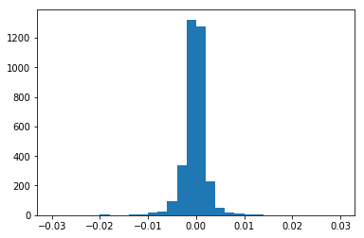
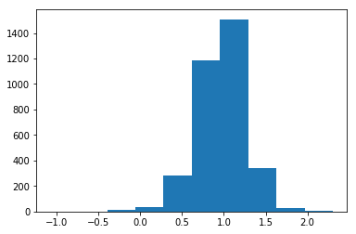
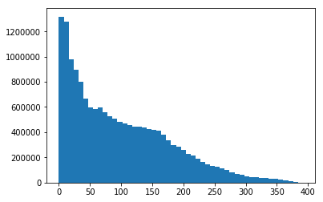
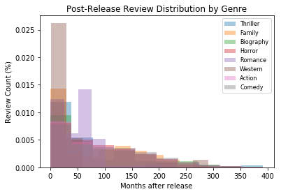
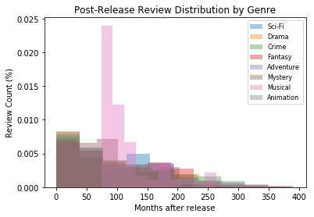
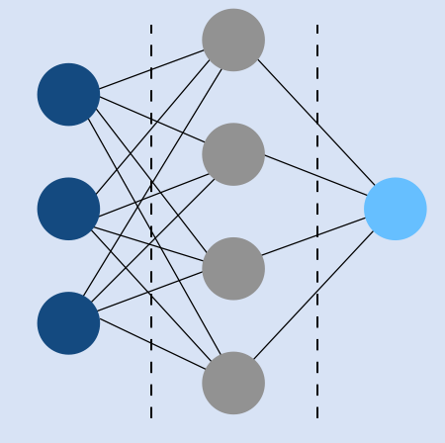
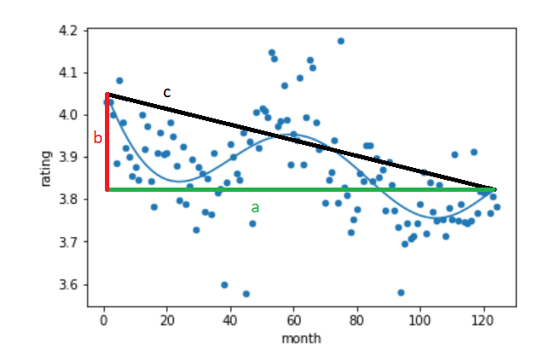
An Investigation into How Movie Ratings Vary Following a Movie’s Release
Summary of Insights
User ratings tend to rate movies more negatively the older a movie is.
Movie metadata and tags are not accurate indicators of the change of movie ratings over time.
Movie metadata and tags become more accurate with a larger time frame.
TEAM 11 | CITADEL DATA OPEN WEST COAST REGIONAL
BACKGROUND
MODEL 1: HOW DO MONTHLY AVERAGE RATINGS DEPEND ON TIME AFTER RELEASE AND CONSUMER PROFILE?
Consumers read product ratings and reviews all the time to make informed consumption decisions. As the film industry enters a Second Golden Age with the emergence of streaming giants, movie ratings are playing an increasingly prominent role in consumer choice. However, as these alternative platforms offer greater viewing flexibility to viewers, viewers’ profiles and their perception towards a specific movie diverge across time. For example, the emergence of Disney+ may mean that fans of the Marvel Cinematic Universe are more likely to catch the upcoming Black Widow movie in cinemas, whereas casual viewers may defer to its release online. Such dynamics may lead to time-based differences in people’s general perception of movies over time. How might we better understand the evolution of consumers’ perception of a movie following its release? Do temporal differences in consumer perception of movies vary across genres? Through understanding these differences, can we predict which movies may behave like hidden gems and grow on consumers over time, and which experiences an initial hype before fading out?
MODEL
OUTCOME
DISCUSSION
We ran a multilinear regression model for movies released during and after 1996 using the following equation.
Distribution
Distribution
Both of our predictors have high statistical significance across our movies dataset, with the user profile predictor having a much higher significance. One interesting observation came in the even distribution in the polarity of elapsed time predictor. Should we be able to classify which movies grow on consumers over time, we can potentially advise streaming platforms on investing in movie streaming rights. We attempt to create such a model in the next section using an artificial neural network.
Movie count
Movie count
the monthly mean rating of a specific movie
the number of months since the movie was first rated
a user’s mean rating, normalized with the mean user ratings for all other users on the platform
Coefficient value
Coefficient value
For the impact of time elapsed since movie release, there is an almost even split on the direction of this impact, with a slightly negative skew, suggesting that monthly ratings decrease slightly over time. This distribution also suggests that impact may vary across movies.
For the impact of user rating profile, the coefficient is generally positive, suggesting that the rating of most movies are in line with people’s expectations. We can also see that there is an uneven distribution near 1.0, suggests
Motivation
In short, we used time elapsed and overall user rating behavior (predictors) to predict a movie’s monthly ratings.
While one would presume most consumers tend to watch movies within a year or two after its release, we found that a bulk of consumers actually continue watching movies many years after (right). These distributions also seem to vary across genres (bottom).
Rating Count After Movie Release Date
Rating count
MODEL 2: DO MOVIE FEATURES DETERMINE THEIR RATING TRENDS OVER TIME?
DISCUSSION
Months after movie release
Hidden Decision Layers
MODEL
Using the various features for our movies, we ran a neural network in an attempt to predict the rating trends based on movie features.
Movie Features
Rating Trends
Our input dataset, which included 100+ features about movie metadata and tags, predicted the variation and change in a movie’s rating over time within one standard deviation. Importantly, our models became significantly more predictive as the time frame increased following a movie’s release. Though seemingly inaccurate, the models in fact highlight two important conclusions. First, it indicates that features other than the metadata must be analyzed. Increased information about the movie’s contents (e.g. transcripts) and about the budget (e.g. marketing), will enable a better prediction.
Second, our model fits better for the longer timeframe. In combination with the observed decrease in ratings over time (Model 1), it clearly indicates that newer movies have an observed higher rating to viewers. Thus, we conclude that a decision for a production firm to prioritize the quantity of movies made rather than the quality may boost total box office sales, similar to the Indian Bollywood movie industry.
Based on the insights from the first model, we decided to further investigate the impact of time elapsed on monthly movie ratings, this time emphasizing the movie features as a predictor for the monthly rating trends over time. We found very distinct shapes when plotting ratings over time, and selected two characteristics to model this behavior.
OUTCOME
We ran two neural networks; one to predict rating variance and one to predict net rating change. We found that our model was not able to consistently predict neither rating variance nor net rating change. When we ran our model on our data for a time frame of 4 months after a movie’s release, it was able to predict rating variance around one standard deviation away, on average, from the movie’s true rating variance. We saw similar results on our net rating change model. We did find though, that our rating variation model became significantly more predictive as we increased the time frame considered following a movie’s release.
DATA
Total significant variance in ratings over time
Net rating change (magnitude and direction)
Features for ~60,000 Movies
Both variables were restricted to the time period between a movie’s release date and n months after release.
Industry metadata such as genre, budget, profit margin, runtime, year released
~28,000,000 User Rating Data from MovieLens
E.g. This is a movie with high variability (comparing curved blue line and black straight line) and negative net rating change (red line).
Unique user ratings for movies with timestamp
Simplified illustration of our artificial neural network, which we use to predict monthly rating trends using movie features
1,128 “Genome Tags” for ~13,000 Movies
Each tag-movie pair has a relevance score based on user feedback

Slide 2
Output Layer: Prediction of Time-Series Trend
Input Layer: Features Time-Series Trends
Hidden Layer
Movie

